Slide 1
2nd Semester Final Test Review

Slide 2
Unit 11
Notes:
M1 got here

Slide 3
What two things did Romanticism focus on?
Notes:
WB tools
Emotion and nature

Slide 4
What replaced human and animal power during the industrial revoluion?
Machines
Solar power
Wind power
Nothing replaced human and animal power
Notes:
A

Slide 5
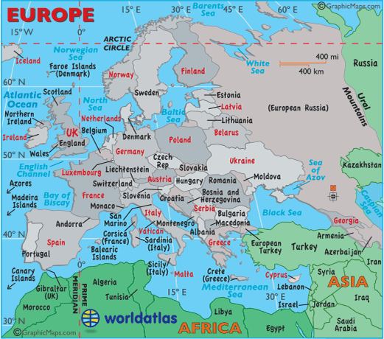
Point to the country that the industrial revolution started in.

Slide 6
True/False: During the 19th century reformers sough to establish change during the industrial revolution. These changes included: A police force, lengthening work hours, and safer working conditions.
Notes:
F

Slide 7
What were the two major transportation changes in Britain during the industrial revolution?
Notes:
Canals and turnpikes
WB

Slide 8
Who was the father of communism?
Notes:
Karl Marx
WB tools and mic

Slide 9
True/False: Private ownership does not exist in a communist society.
Notes:
False

Slide 10
Who developed the theory of natural selection?
Karl Marx
Eli Whitney
Thomas Malthus
Charles Darwin
Notes:
D

Slide 11
Who invented the electric Telegraph?
Notes:
Samuel Morse
WB tools and mic

Slide 12
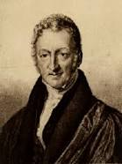
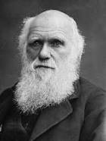
These two men claimed that humans competed for natural resources. Who are they?
Notes:
Darwin and Malthus
WB tools and mic

Slide 13
What was the goal of the abolition movement? Circle the answer on the board
To free America from the British
To end slavery
To give women the right to vote
To free India from Britain
Notes:
To end slavery

Slide 14
Unit 13

Slide 15
Raise your hand to match the generals to their armies!
Robert E. Lee
Union
Confederacy
Ulysses Grant
Notes:
Raise hand for tools

Slide 16
Raise your hand to match the Presidents to their “nations”!
Abraham Lincoln
Union
Confederacy
Jefferson Davis
Notes:
Raise hand for tools

Slide 17
Which battle was a turning point for the north in the Civil War?
The Battle of Antietam
The Battle of Bull Run
C. The Battle of Gettysburg
D. The Battle of Lexington
Notes:
C

Slide 18
What material helped to spark the Second Industrial Revolution?
Notes:
Steel
WB tools and mic

Slide 19
Circle the answer: Who invented a three-wheeled vehicle with a steering wheel and brakes?
Karl Benz
Henry Ford
Notes:
Benz
WB tools

Slide 20
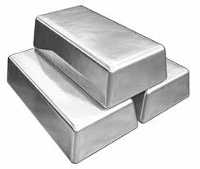
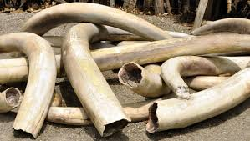
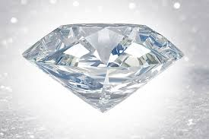
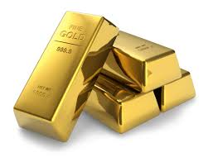
Point to the answer: what industry did Cecil Rhoades have control of within 20 years of arriving in Africa?

Slide 21
Who was the first European to cross Africa?
Notes:
David Livingstone
WB tools and mic

Slide 22
True/False: Europe was able to gain control of most of the African continent because they had advanced weapons, railroads and steamships (to move troops, supplies and raw materials), and Africans thought all Europeans were actual gods.
Notes:
False

Slide 23
True/False: The Sepoy Rebellion was an Indian uprising against the British East India Tea Company’s rule. After the rebellion the company was taken out of India and the British government took over.
Notes:
True

Slide 24
This canal was constructed so Europeans could avoid a long, dangerous, and expensive trip around Africa to reach their colonies in Asia.
Notes:
Suez Canal
WB tools and mic

Slide 25
List the motivations for New Imperialism
Notes:
Raw materials, fuel, and new markets

Slide 26
Unit 14

Slide 27
Who was the man to introduce the 5 day work week and make cars available for most of America?
Notes:
Henry Ford
WB tools and mic

Slide 28
True/False: Trade unions were organized to help workers fight for better pay, working conditions, and shorter work hours.
Notes:
True

Slide 29
Circle the answers: who transformed newspapers into a form of entertainment?
Henry Ford
Joseph Pulitzer
Vincent Van Gogh
Pablo Picasso William Randolph Hearst
Franz Josef
Notes:
Pulitzer and Hearst
WB tools and mic

Slide 30
Naturalist believed that people are shaped by their….?
Environment
Unconscious mind
Friends
Notes:
A

Slide 31
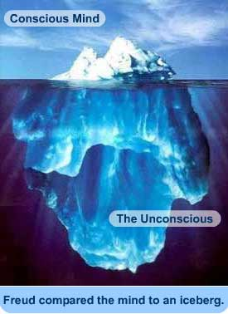
Who compared the human mind to an iceberg?
Notes:
Sigmund Freud
WB tools

Slide 32
Matching: I need 4 volunteers
Abstract
Cubism
Impressionism
Post Impressionism
Used geometric shapes, showed subjects from different angles, and eliminated the illusion of space
Showed great emotion
Creates art of the elements of art itself
Tried to capture a moment in time
Notes:
Abstract: The art that creates art out of the elements of art itself
Cubism: Used geometric shapes, showed subjects from different angles, and eliminated the illusion of space
Impressionism: The art style that tried to capture a moment in time
Post Impressionism: The art style that showed great emotion
WB tools for some

Slide 33
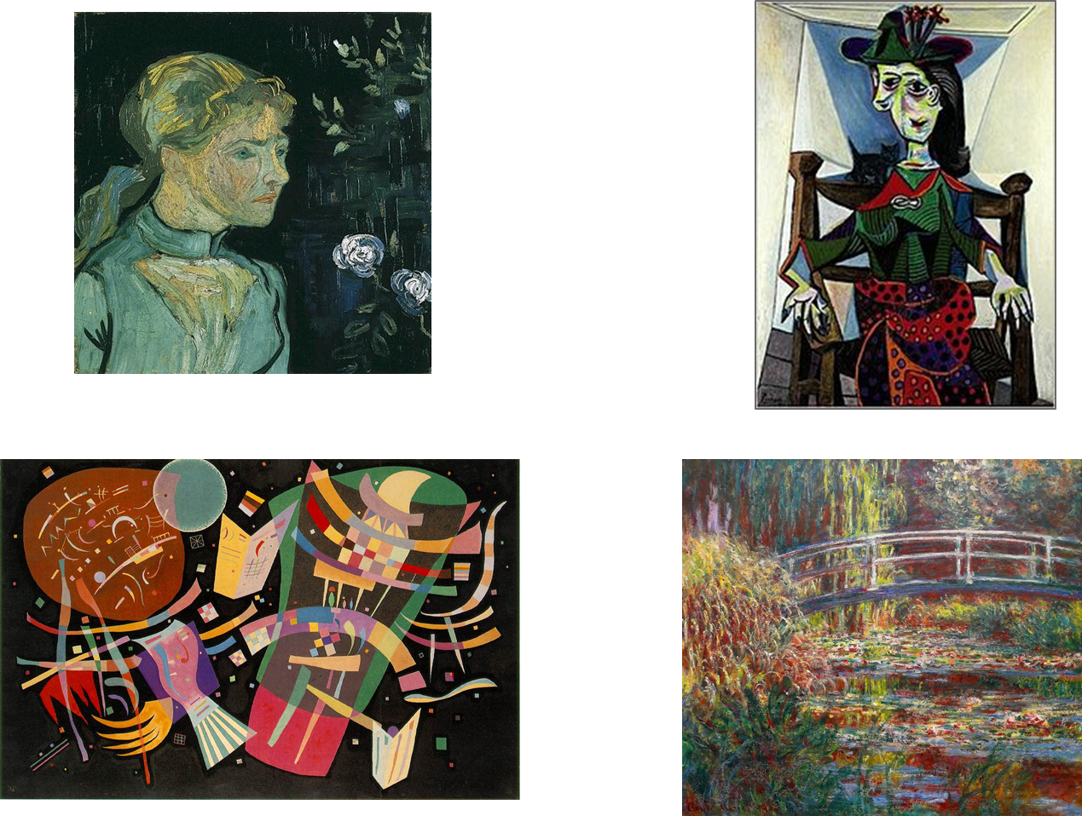
Notes:
Moveable pieces on the board, have them answer in chat then move the pieces– post impressionism, cubism, abstract, impressionism

Slide 34
Unit 15

Slide 35
Who led the Indian Independence movement?
Franz Josef
Sun Yet-sen
Mahatmas Gandhi
Notes:
C

Slide 36
Cursor on the answer: the Wright brothers first took flight in Kitty Hawk, SC. What year did this take place?
1900 1899
1896
1903
1912 1950
1890
1917
1888
Notes:
1903

Slide 37
_________ _________ was a stunt pilot that was trained in France and drew crowds to her shows in the United States.
Notes:
Bessie Coleman
WB tools

Slide 38
Who was the emperor of the new Austro-Hungarian Empire?
Notes:
Franz Joseph
WB tools and mic

Slide 39
Why was the panama canal constructed?
Notes:
It was an easier and shorter way to travel from New York to San Francisco
WB tools and mic

Slide 40
What two countries were involved in the construction of the panama canal?
U.S and Britain
U.S and France
Germany and France
Panama and Germany
Notes:
B

Slide 41
Any questions?
The test will be 50 questions
It will be worth 50 points
Any questions about the material?
I suggest you look over your notes before you take it and take your time tomorrow
. There will be no surprises. So don’t take it a first time just to see what the questions look like. You already know.

Slide 42
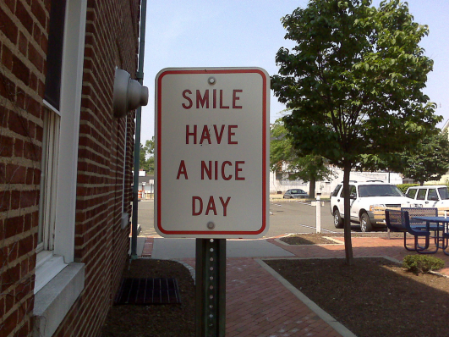
WOOOOOOO!!!!!!
Y’all did awesome with your review the past few days! Which hopefully means you will do awesome on your final!
Things to remember:
- Look over your notes BEFORE class
- You may use your notes to help you with your final
- Tomorrow is Friday, so power though the rest of the day!

